Slide 1
McKinnon update

Slide 2

Internal report content

Slide 3
What has happened to Federal Spending?
Something from report

Slide 4
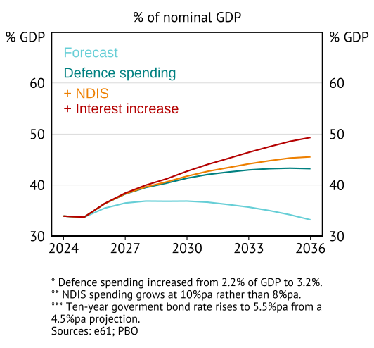
What are some key spending risks
Gross debt projection

Slide 5
Extended spending work

Slide 6
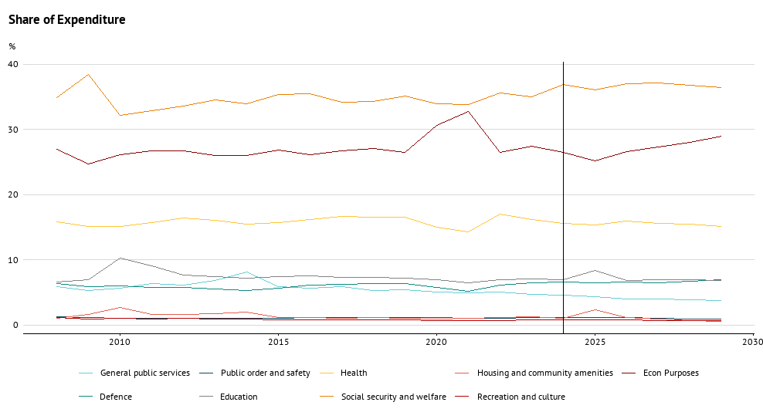
Where has Federal spending growth occurred?
The make-up of Federal spending growth has been surprisingly flat

Slide 7
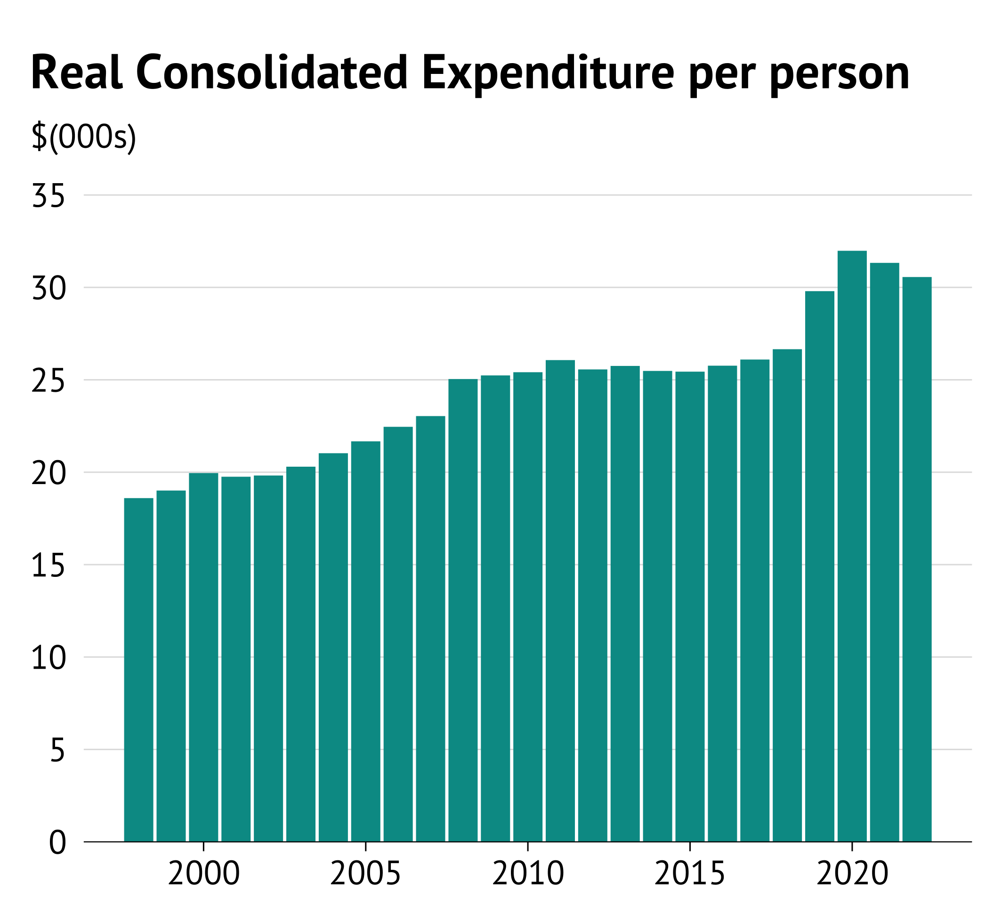
Overall Government Expenditure (Consolidated)
Spending per person
STIK by income decline

Slide 8
Where has Expenditure growth occurred?
ABS data to decompose this by age
To consider where spending pressures could be restrained we need to define appropriate benchmarks.

Slide 9
Topics
There are three measurement and communication areas where additional work could improve understanding of fiscal pressures.
Consolidation – taking an all of government approach to spending on functions
Benchmarking – international, demographic, and forecast based benchmarks
Tracking – how do we interpret, communicate, and update the above insights.
Work on short-termism is within a separate, but related, stream – Kizzy and Michael are leading this directly.
Summary: Australia has become a high general government spending country, while using a tax and transfer system built for a small government.

Slide 10
Consolidation
OECD Fiscal Decentralisation (Spending by Function, COFOG)
ABS Government Fiscal Standards (Operating Statements and Balance Sheets)
Requesting ABS data that combines these – should have detailed data available within two-weeks to analyse.

Slide 11
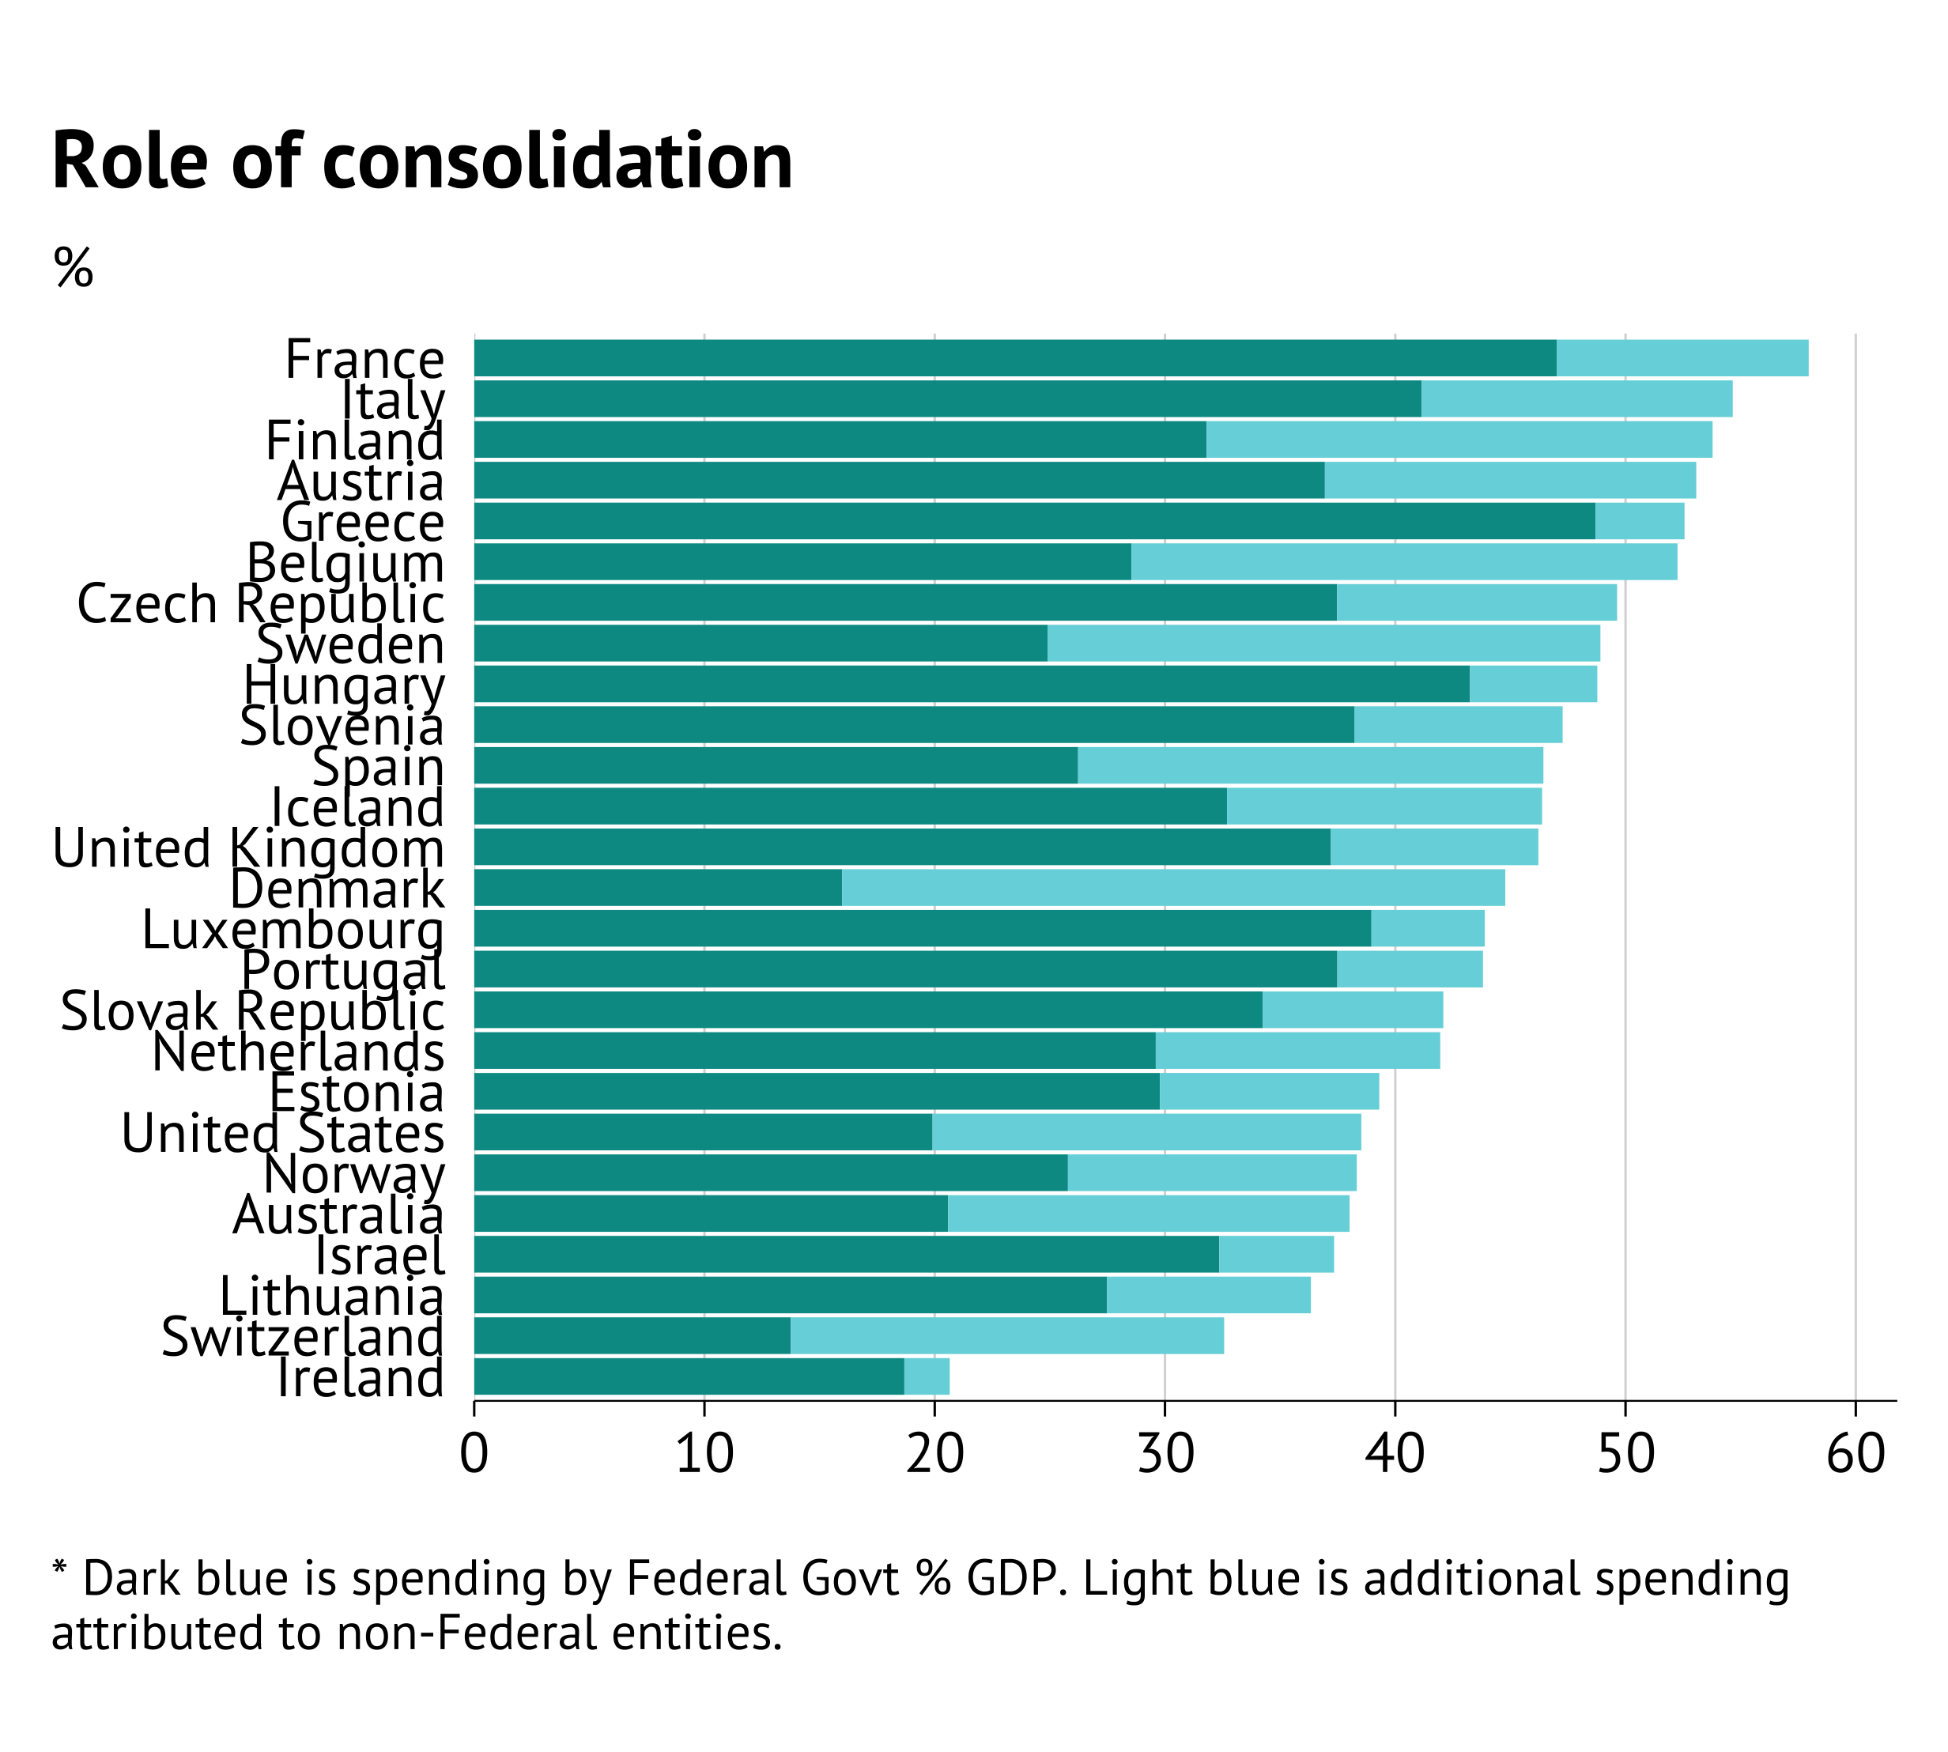
What does consolidation tell us?
In General Spending
Consolidated government spending was 37% of GDP in 2021/22 (compared to 24.8% at the Federal level).
However, this is low internationally.
In deficit terms
[report showed that this meant that net debt does not decline]
[from consolidation, there is a deficit but it is relatively small compared to other countries]
Notes:
Goal is to attribute functions funded by Federal government but undertaken by State government to a shared account – Federal revenue and expenses are both increased by GST, but given the nature of how it is provided unconsolidated balance sheets don’t tell us the exact function that this activity is always supporting. The purpose of consolidation is to look through this.

Slide 12
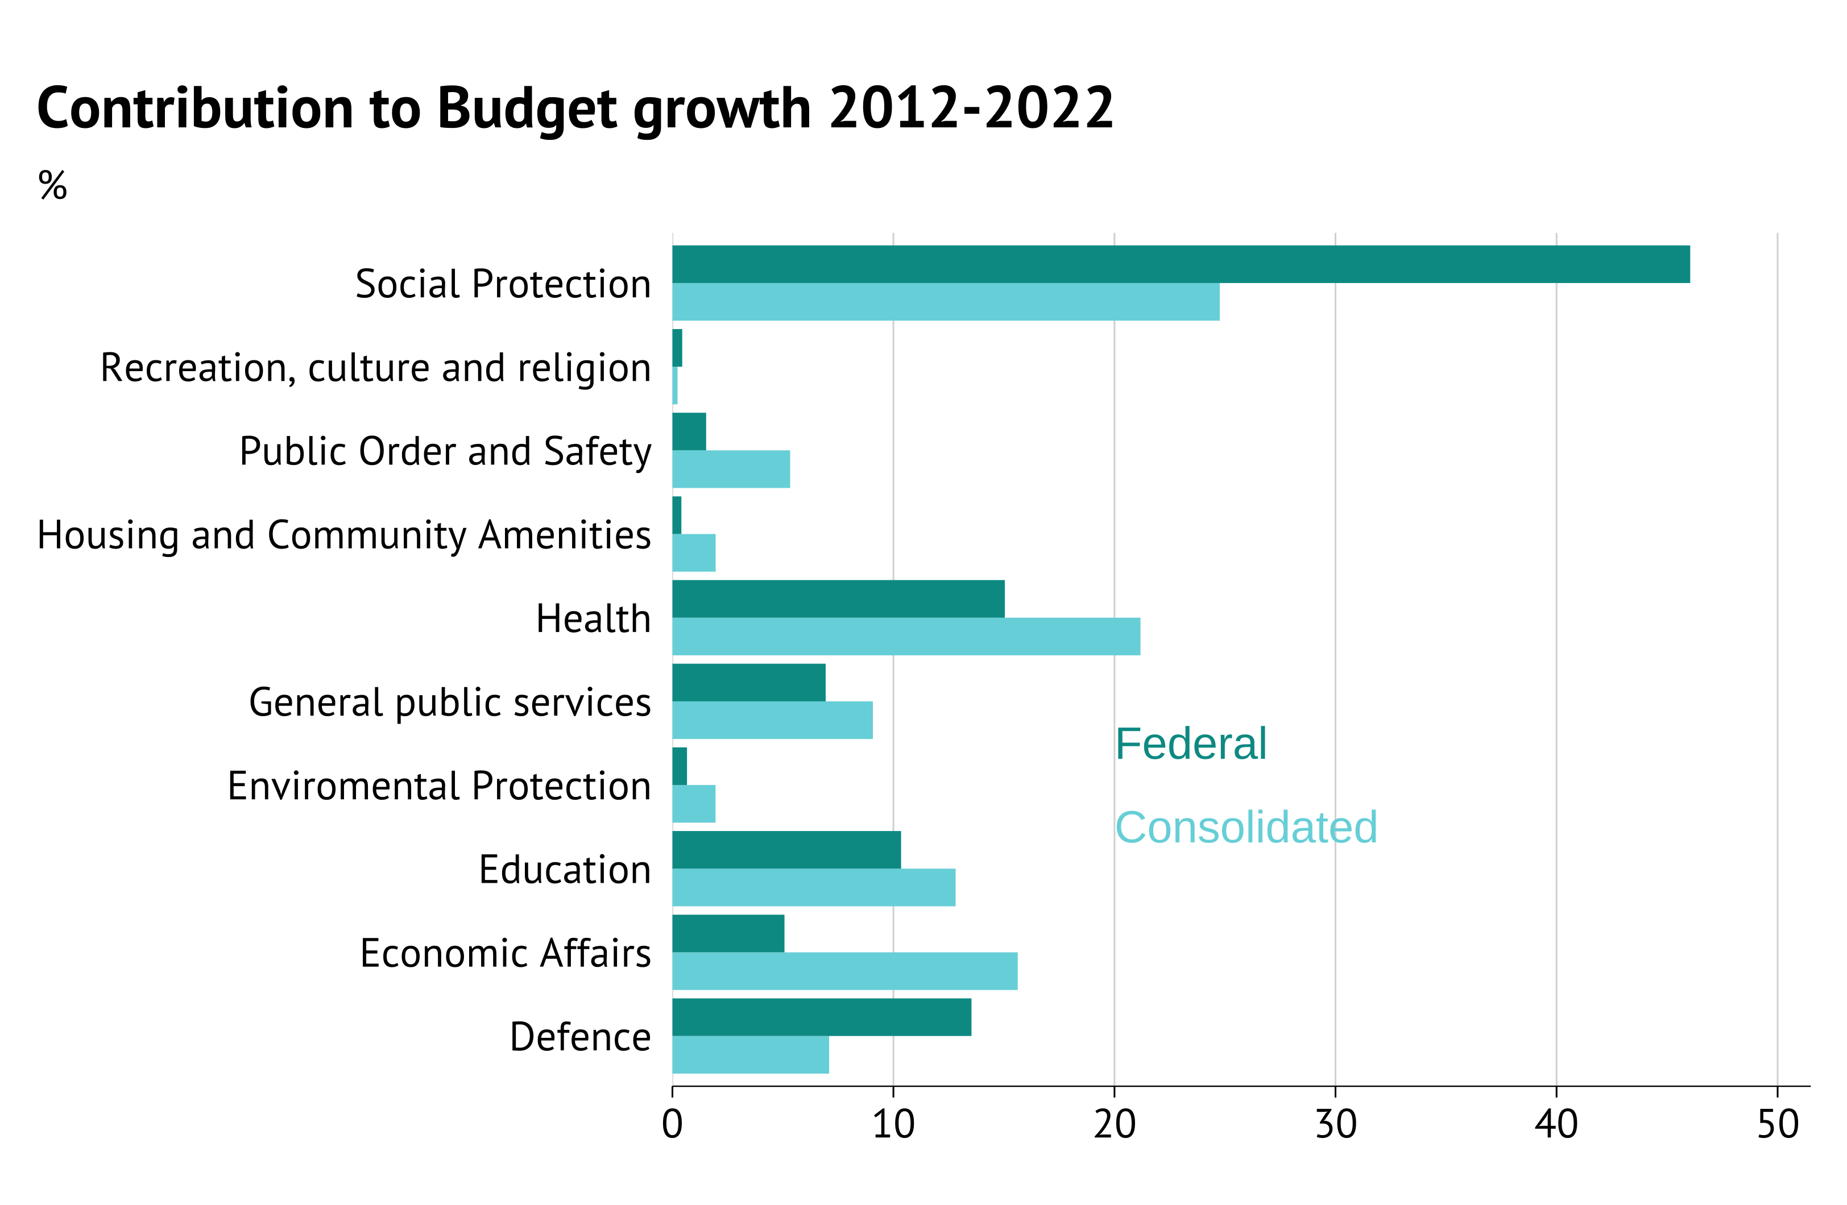
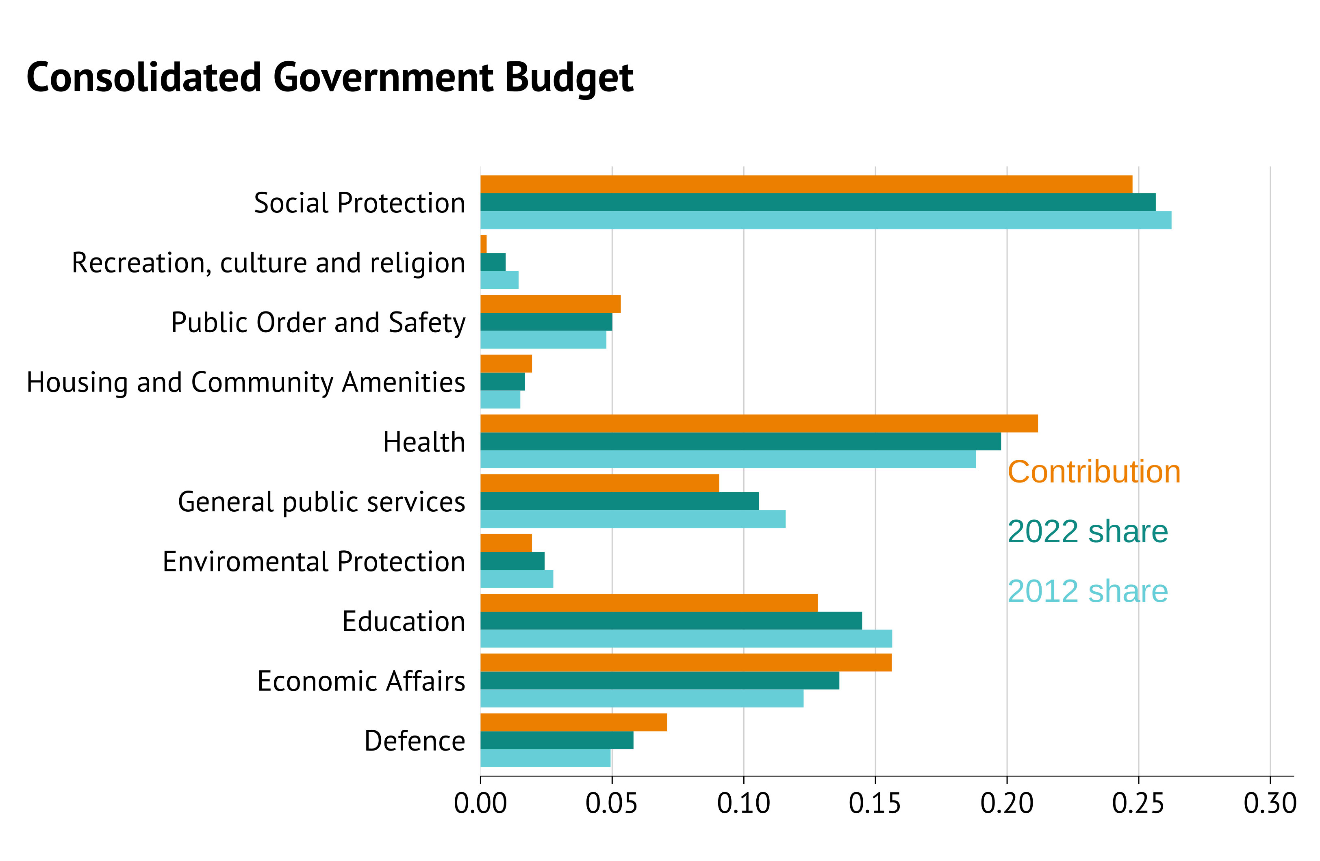
Where has consolidated spending growth occurred?

Slide 13
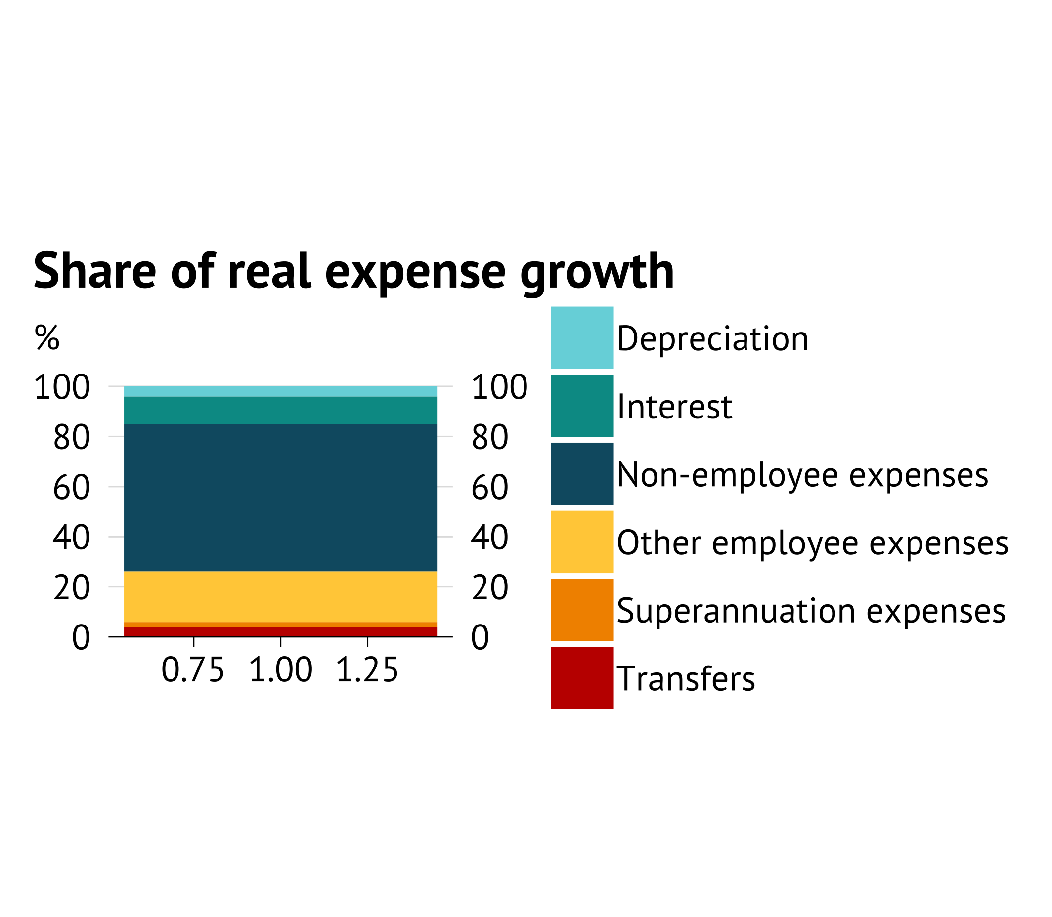
Where has consolidated spending growth occurred?
In the GFS (inputs)
Since FY15, the largest contributor to real cost growth has been “non-employee expenses”.
59% of growth, from 39% of the total spend.
This reflects the large push to provide funds for private services – rather than direct service provision.

Slide 14
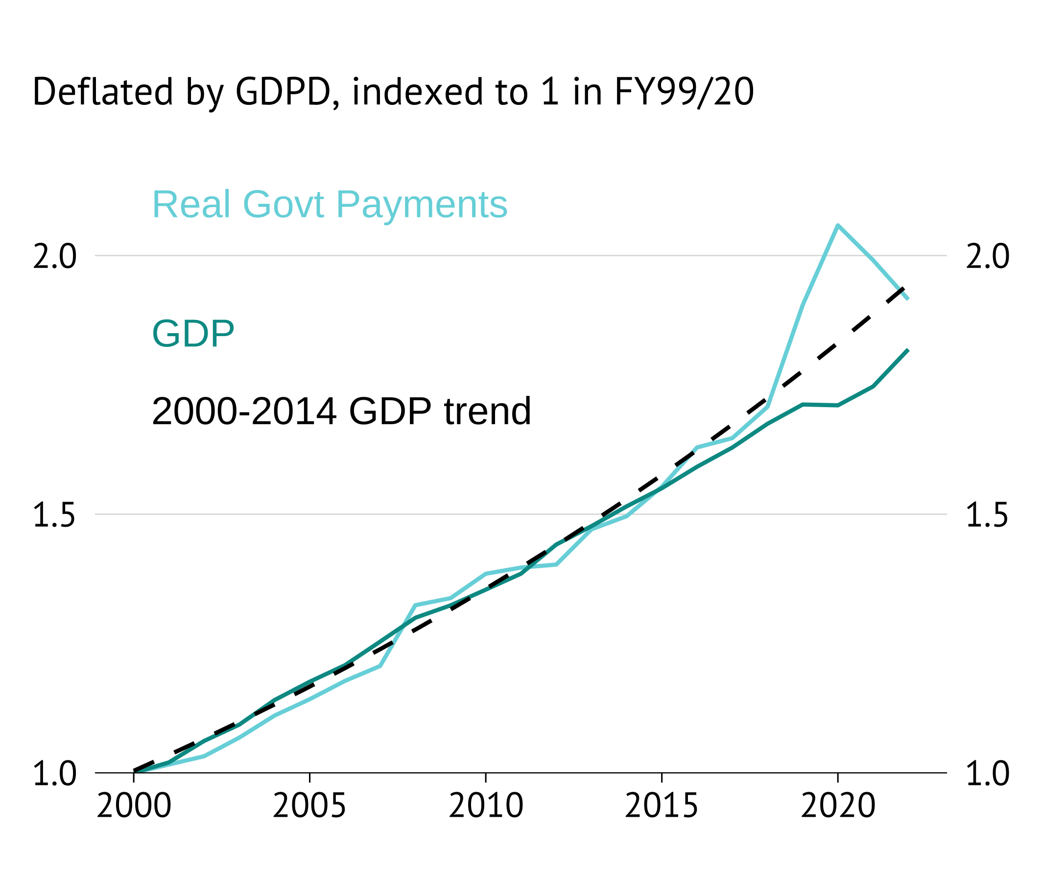
What does consolidation tell us?
Stickiness of expenditures (short-termism)
Growing expenditure with all categories rising together may suggest Budgetary processes that are sticky.

Slide 15
Benchmarking
International
OECD division COFOG data.
Synthetic control exercise to benchmark against “similar” countries.
Adjusted expenditures
Disaggregated COFOG
Use demographic and economic factors to build benchmarks.
Sectors:
Health,
Education,
Public admin (ex defence),
Defence,
Other expenses

Slide 16
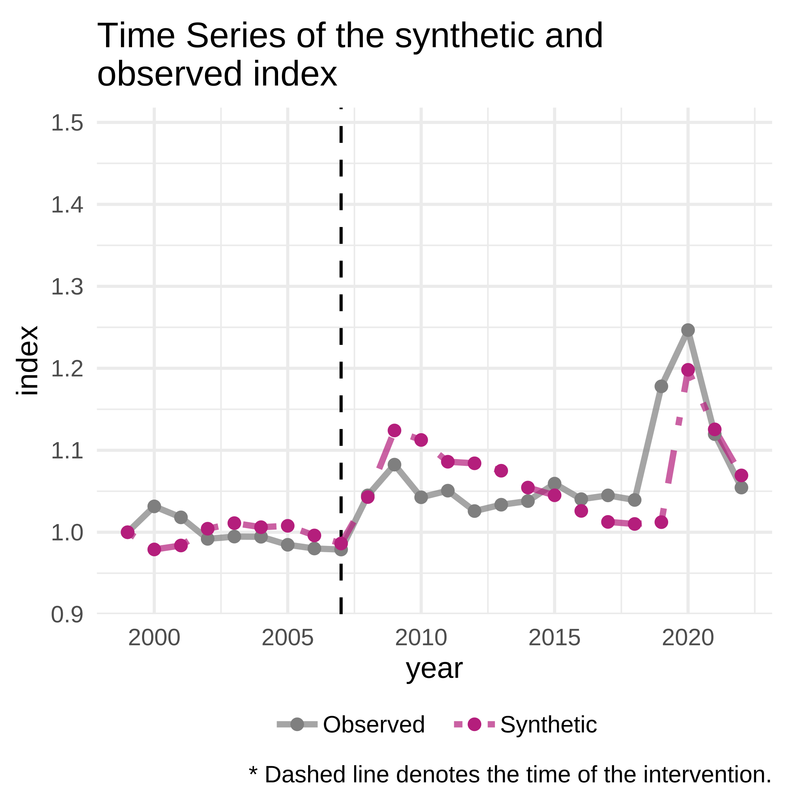
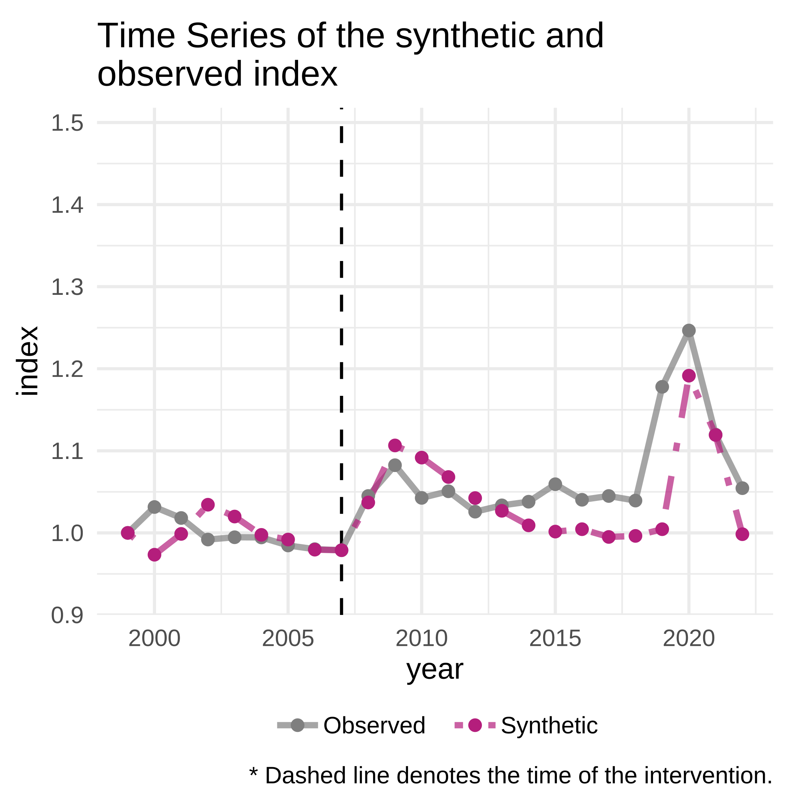
International Benchmarking
Synthetic control exercise on overall spending
Initial – Exp/GDP
Age adjusted – Exp/GDP
Relative to countries with similar E/GDP ratio movements prior to the GFC, Australia has risen.
Something (after adjustments)
Key question is what has driven this.

Slide 17
International Function Benchmarking
XXX
XXX
XXX
Health spending example

Slide 18
Forecast Function benchmarking
Relative to forecasts
Decisions made will typically ensure that spending exceeds projections – especially given the conservative spending allowance.
Take projections.
Add:
Share of CSA
[any other amount to add]
This provides the benchmark by function provided.

Slide 19
Demographic Functional Benchmarking
Sector stuff
Health spending example
XXX
XXX
XXX

Slide 20
Input costs
Check if we can find international IFRS GFS type standards to compare types of inputs used.

Slide 21
Tracking and projections
Adjusted expenditures
Per capita capital stocks

Slide 22
Capital stock reporting
XXX

